Slide 1


Slide 2

Starter task:
Describe your weekend in the following ways:
. A colour
. An animal
. An emotion/feeling

Slide 3
The mandatory content
Existence of God mandatory content.
Does God exist?
. What arguments/theories do religious people use to prove the existence of God?
. What evidence do religious people use to support these arguments/theories?
. What are the strengths and weaknesses of evidence/arguments/theories?
. What arguments/theories do non-religious people use to challenge the existence of God?
. What evidence do non-religious people use to support these arguments/theories?
. What are the strengths and weaknesses of evidence/arguments/theories?
. Can either religious or non-religious arguments/theories provide conclusive proof about the existence of God?

Slide 4
Learning Intention:
Today we are learning about the teleological argument from Paley's viewpoint.
Success criteria:
By the end of the lesson I will be able to:
Clearly explain Paley’s argument!

Slide 5
13.12.22 The Teleological Argument
The Teleological Argument can sometimes be known as the argument from design.
This argument suggests that simply by looking around us we have to reach the conclusion that the world we observe must have had an intelligent designer who created it with purpose.
Evidence to support this is taken from the fact that the world is so ordered and structured in such a precise way that the only explanation for such existence in the existence of an intelligent designer.

Slide 6
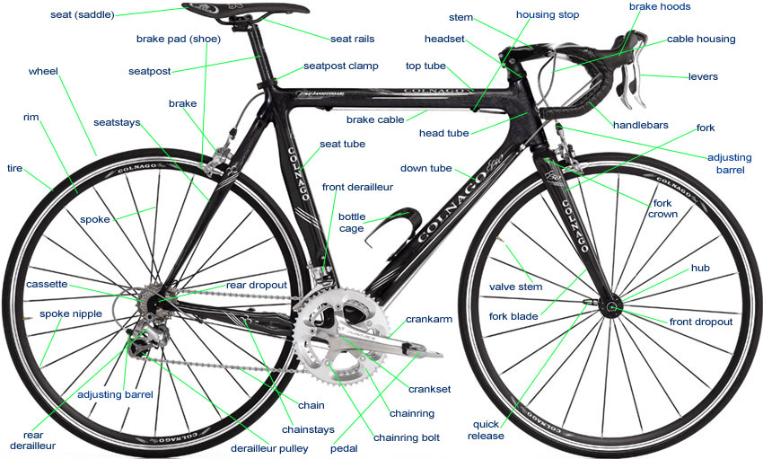
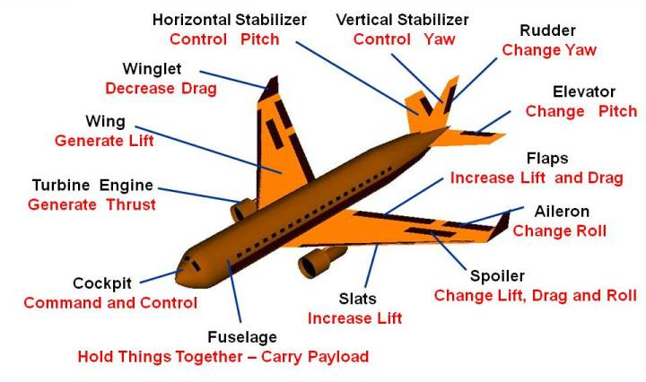

The complexity in human objects comes from having been designed and made for a purpose by an intelligent human beings.

Slide 7
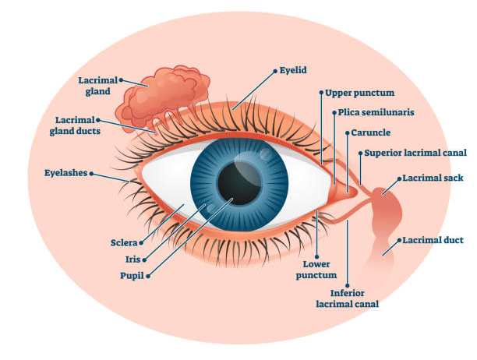
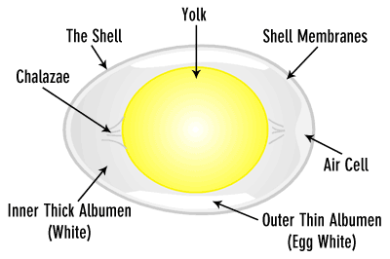
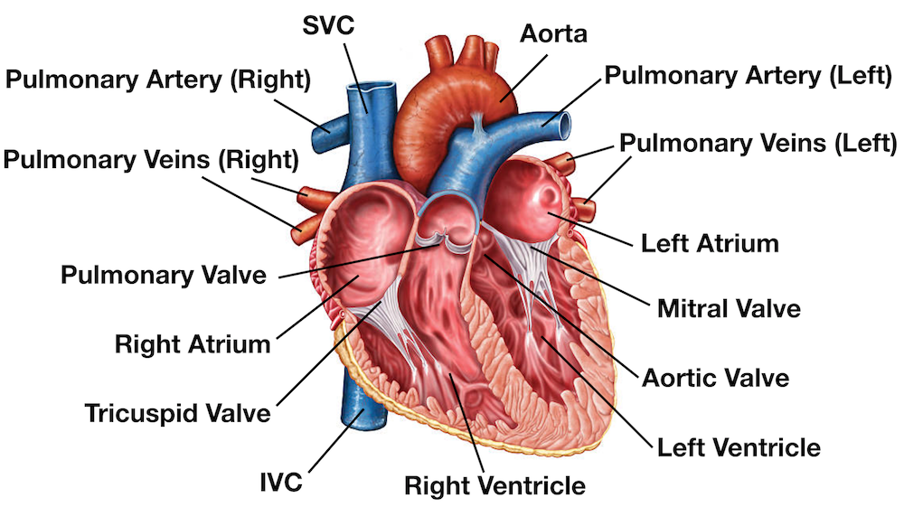
Looking then at the complexity of natural phenomena such as an egg, eye or heart they to seem to have been designed with a purpose by an intelligent designer.

Slide 8
Complexity Purpose Design
What do these words actually mean?
This religious argument states that all life on earth is complex, purposeful and displays signs of being designed, much like human inventions. (KU)
It argues that because both things share the same qualities we can reasonably assume that life of earth has been created by an inventor and the conclusion is this is God. (AN)

Slide 9


To explain his theory, Paley used an analogy.
An analogy is a story that compares two things; usually something abstract (like an idea or belief) and something concrete (an object we can see and understand).

Slide 10
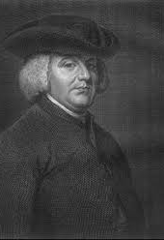
William Paley.
. July 1743 – 25 May 1805 (500 years after Aquinas)
. English clergyman.
. Philosopher.
. Wrote several famous books, one of which was studied at Cambridge University for over 100 years.

Slide 11
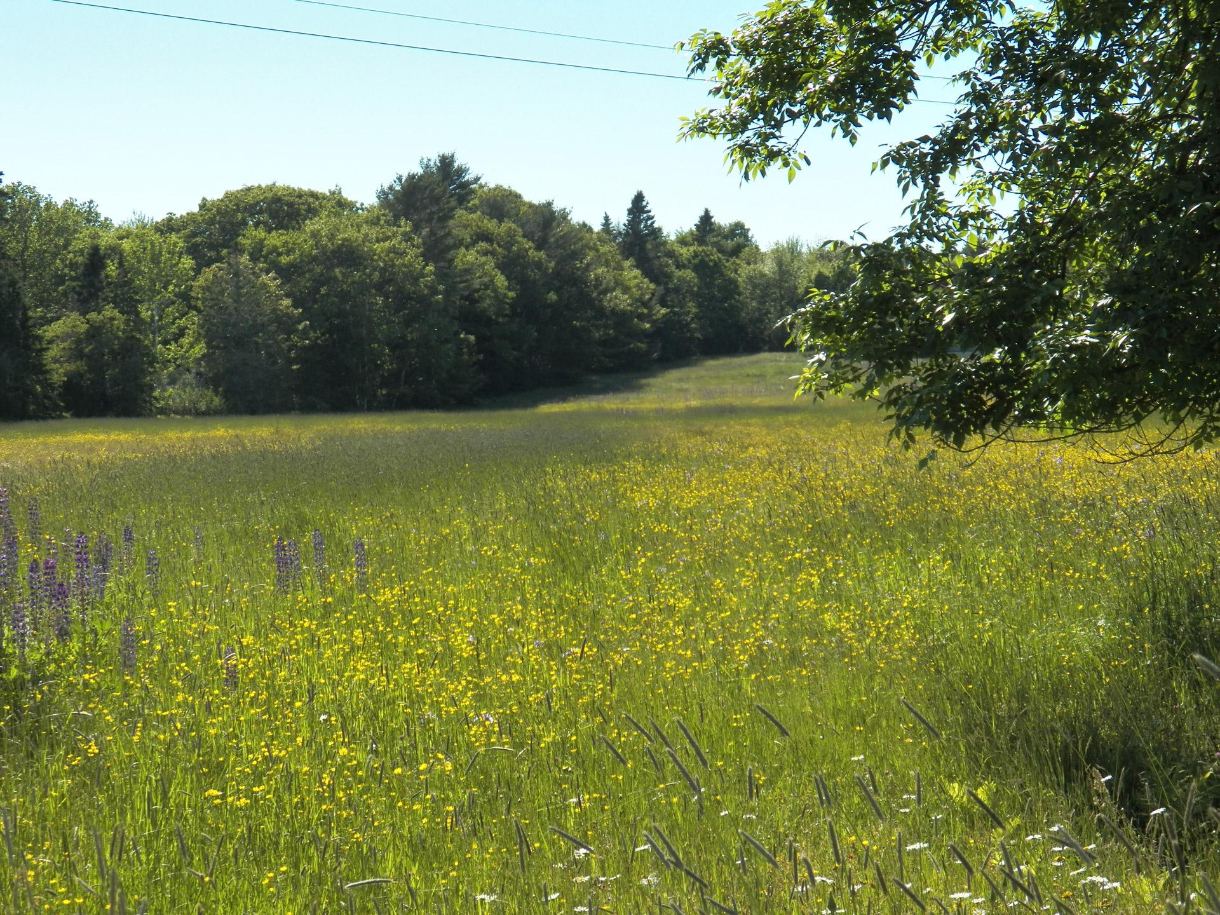
Imagine you are walking through a field…
You see a stone on the ground, you presume it has always been there, needing no one to design it.

Slide 12
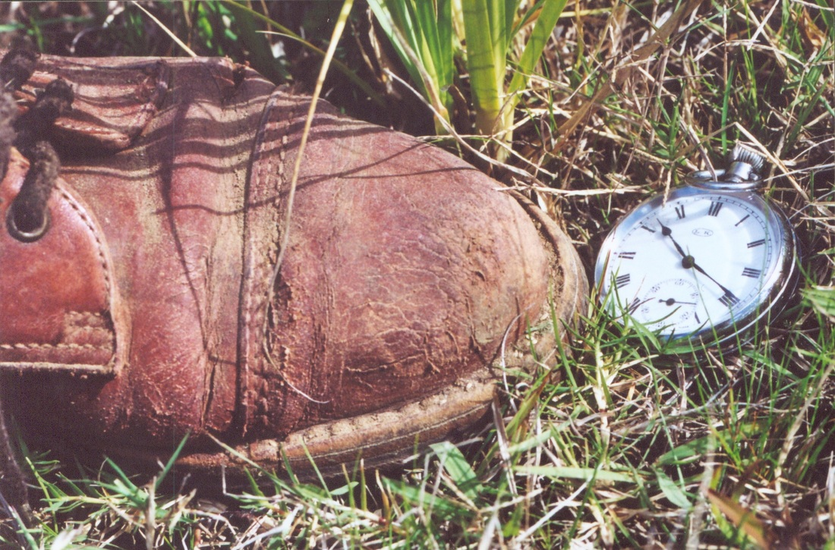
Then you see a watch on the ground.
You have never seen a watch before so you pick it up and examine it. You see that it is very complicated (cogs, moving hands, glass, a case). You would naturally wonder where it came from.

Slide 13

You would look at the complexity of the watch and conclude that it could not have just randomly appeared and that someone must have made it.

Slide 14

If you observed the watch for a while, you would understand that it had a purpose (or job)…
… to tell the time.
The way the watch is designed makes it perfect for it’s purpose.
The chances of this coming about randomly are so slim that it is almost impossible. So…
There must be an intelligent designer that made the watch for it’s particular purpose.

Slide 15

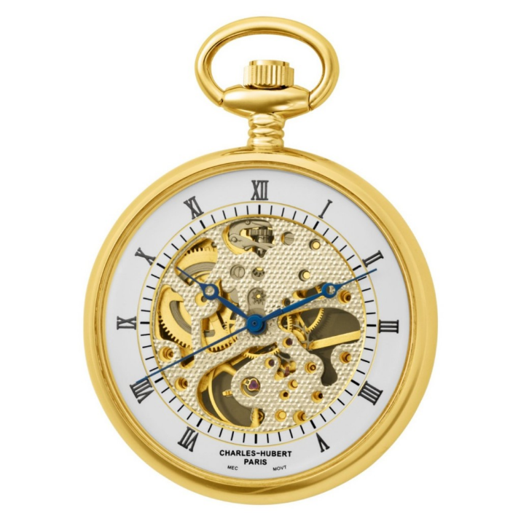
In Paley’s Watch Analogy, the watch represents or is being compared to the universe.
Paley argues that, like the watch, the way the universe works in perfect order and is perfectly suited for so many species to live on could not have come about by random chance.
The universe must have an intelligent designer and the designer must be God.

Slide 16
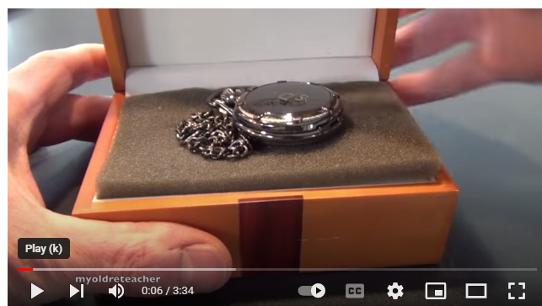
Lets watch this to develop our understanding.
https://www.youtube.com/watch?v=3HJVfB1h_48

Slide 17
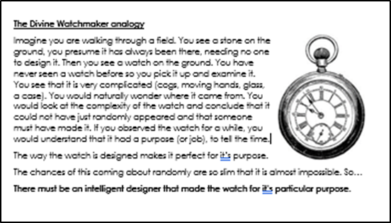
Paley’s Argument:
The universe is highly complicated. Within the complex universe there are millions of other complicated processes (like the tides, change of seasons, circle of life, etc.).
It is highly unlikely that all these things work so effectively together by random chance.
It is more likely that something designed the universe that way.
That designer is God.
Read through the notes on Paley and stick them in.

Slide 18

So what is your reaction to this theory so far?
Strengths and weaknesses?
Issues or questions?

Slide 19
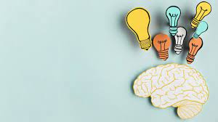
Task:
Using the information we have gathered so far write a short paragraph explaining Paley's watch analogy.
It should include one KU mark, and one AN mark

Slide 20
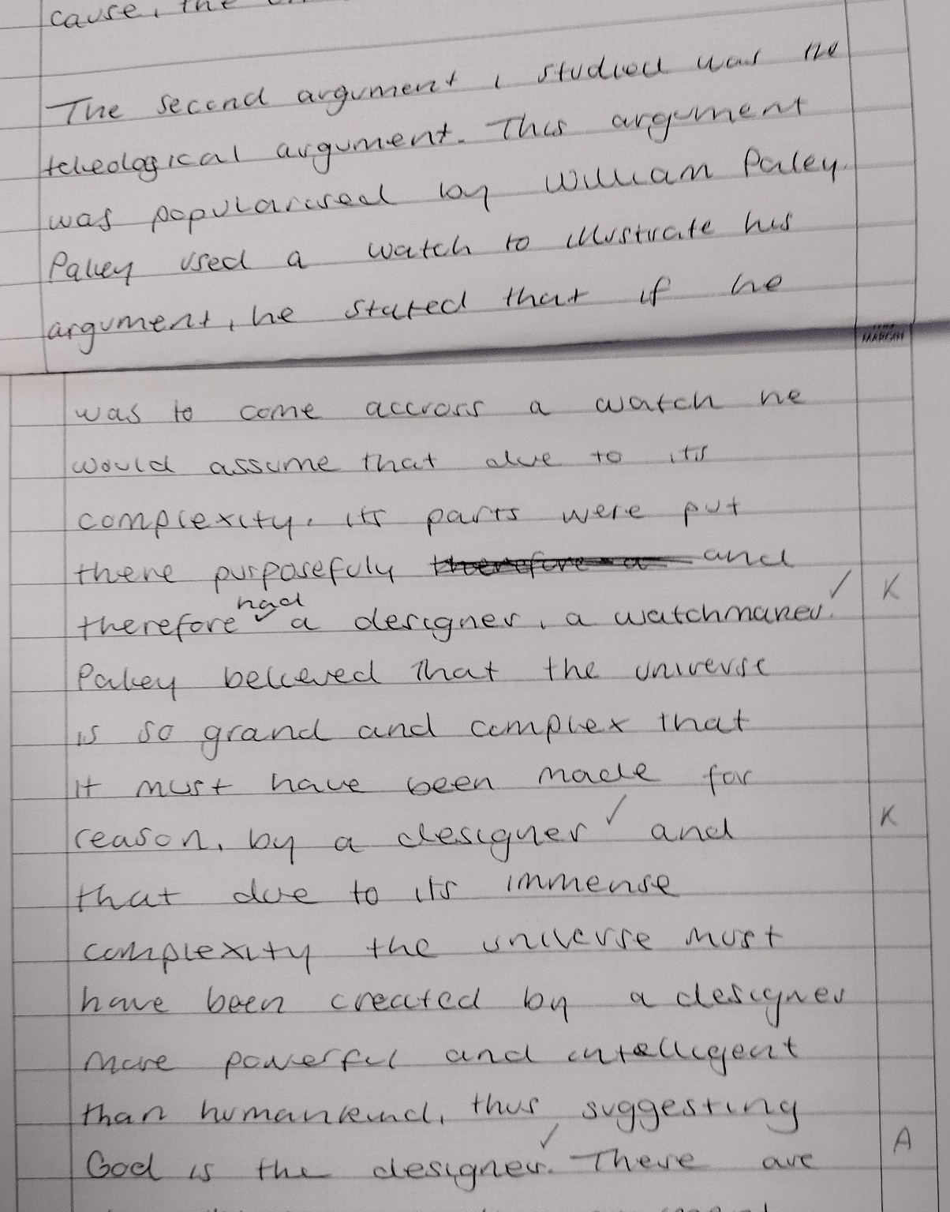
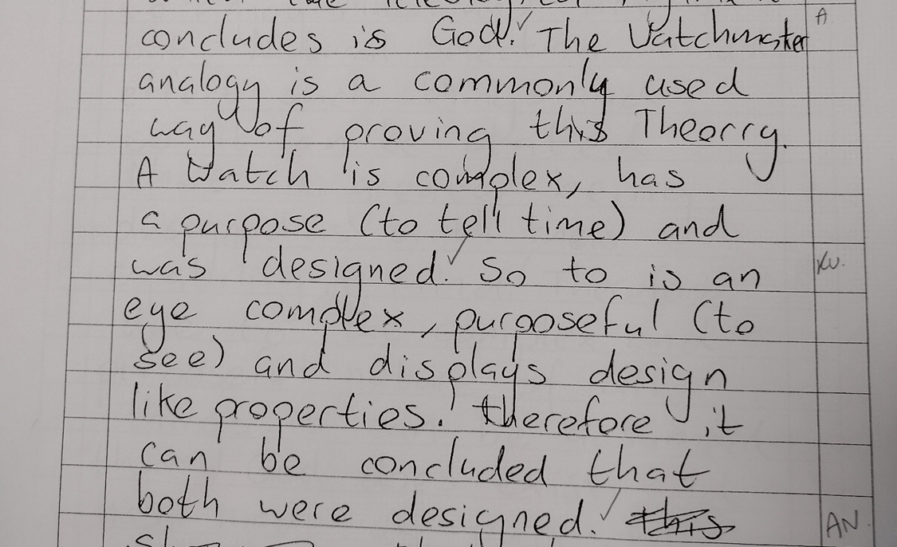
Here are some example answers.

Slide 21
The Argument from Analogy
The most straightforward teleological argument is the argument from analogy:
1. The natural world around us resembles the objects of human creation in that they both display complexity.
2. The complexity of human objects comes from having been designed and made by intelligent beings (humans).
3. We have no reason to assume that what is true for human objects should not be true for the world around us.
4. Therefore, the complexity in the world around us comes from having been designed and made by an intelligent being (God).

